Slide 1
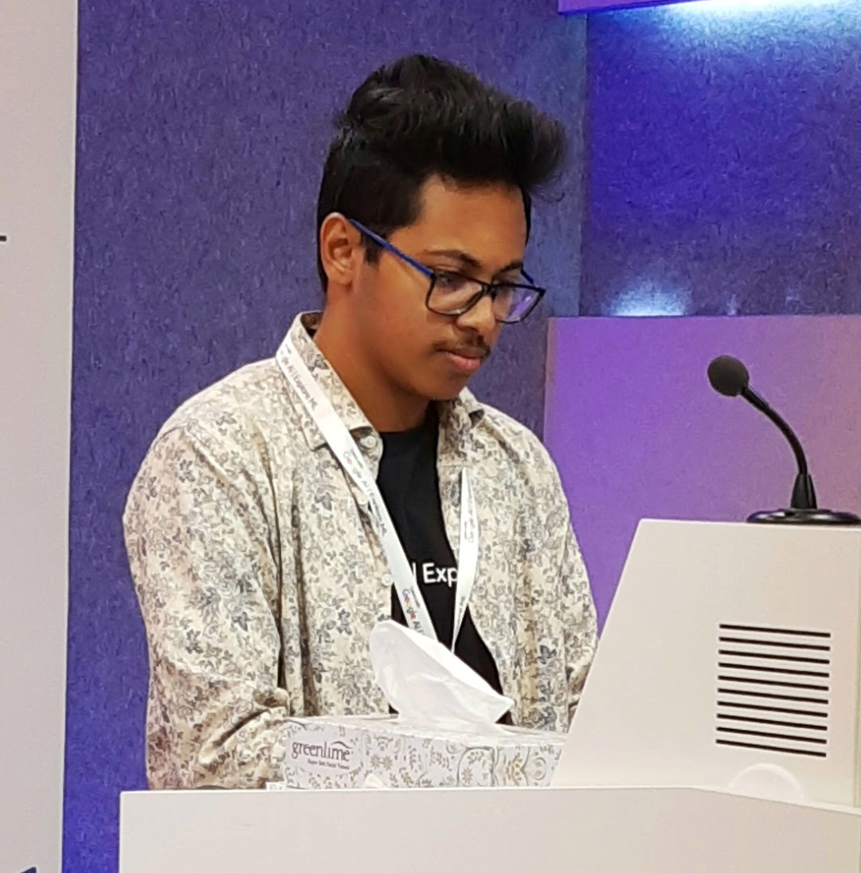
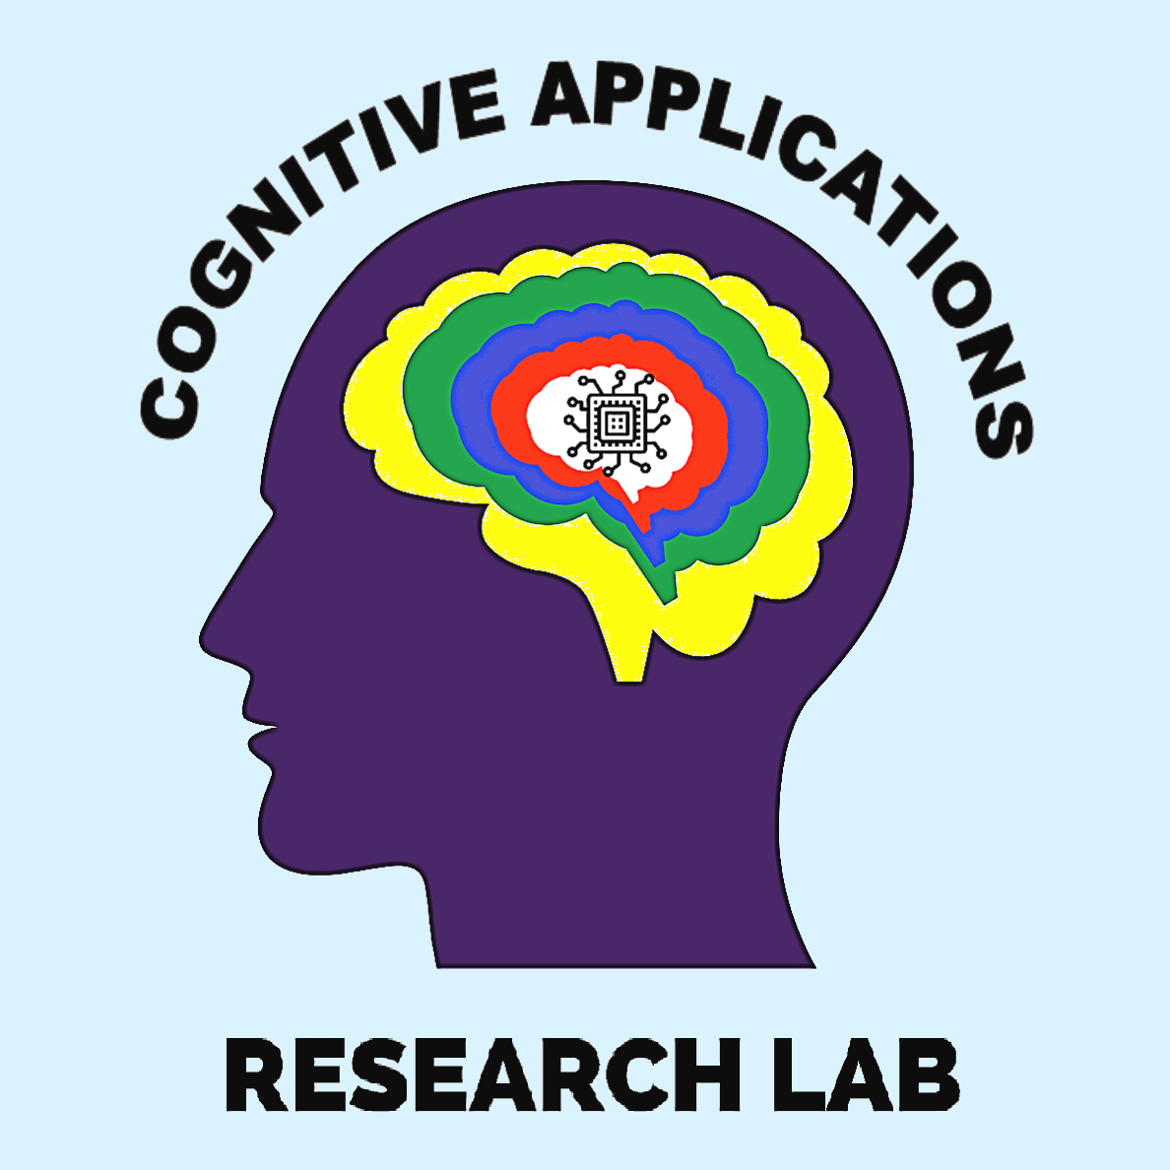




Explaining AI:
From Regression to Computer Vision
Aditya Jyoti Paul
@phreakyphoenix
Founder and Team Lead,
Cognitive Applications Research Lab (CARL)
Google AI ExploreML Facilitator

Slide 2
What is Machine Learning?
Notes:
Let's review. How would you explain machine learning?
Answers could include (shown on the following slides):
Machine learning is a specific field of AI where a system learns to find patterns in examples in order to make predictions.
Computers learning how to do a task without being explicitly programmed to do so.

Slide 3
What is ML
Machine Learning systems take inputs (data) to make useful predictions and decisions about previously unseen pieces of data.
Pattern matching in examples in order to make predictions.

Slide 4







Machine Learning
Supervised
Unsupervised
Model is trained on labeled data
Model learns patterns from unlabelled data.
stop_sign_1
stop_sign_2
stop_sign_3
stop_sign_4
Notes:
Machine learning looks for patterns in data.
The majority of ML applications today are supervised learning where labeled data is used to teach the model. This includes tasks like classification and regression.
Supervised machine learning is analogous to a student learning a tricky maths concept by studying a set of questions and their corresponding answers. After mastering the mapping between questions and answers, the student can then provide answers to new (never-before-seen) questions on the same topic.
The signs on the left are labeled data so a supervised machine learning system could learn from these labels what stop signs around the world look like.
The signs on the right are unlabeled data. Even the sign with the word stop because labeled data requires a human's rating to indicate what it is.
Images:
https://wikipedia.org/wiki/Stop_sign
https://wikipedia.org/wiki/Comparison_of_European_road_signs

Slide 5
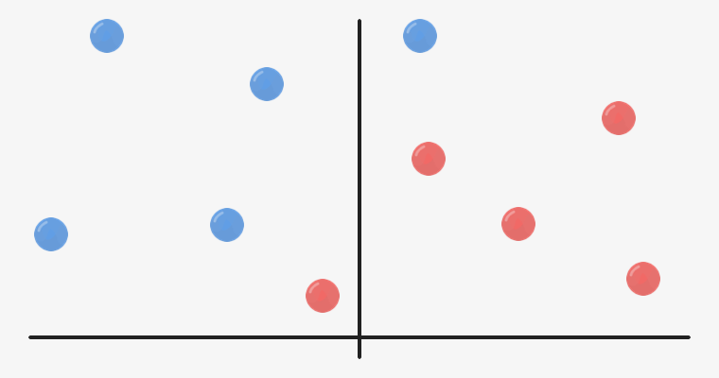
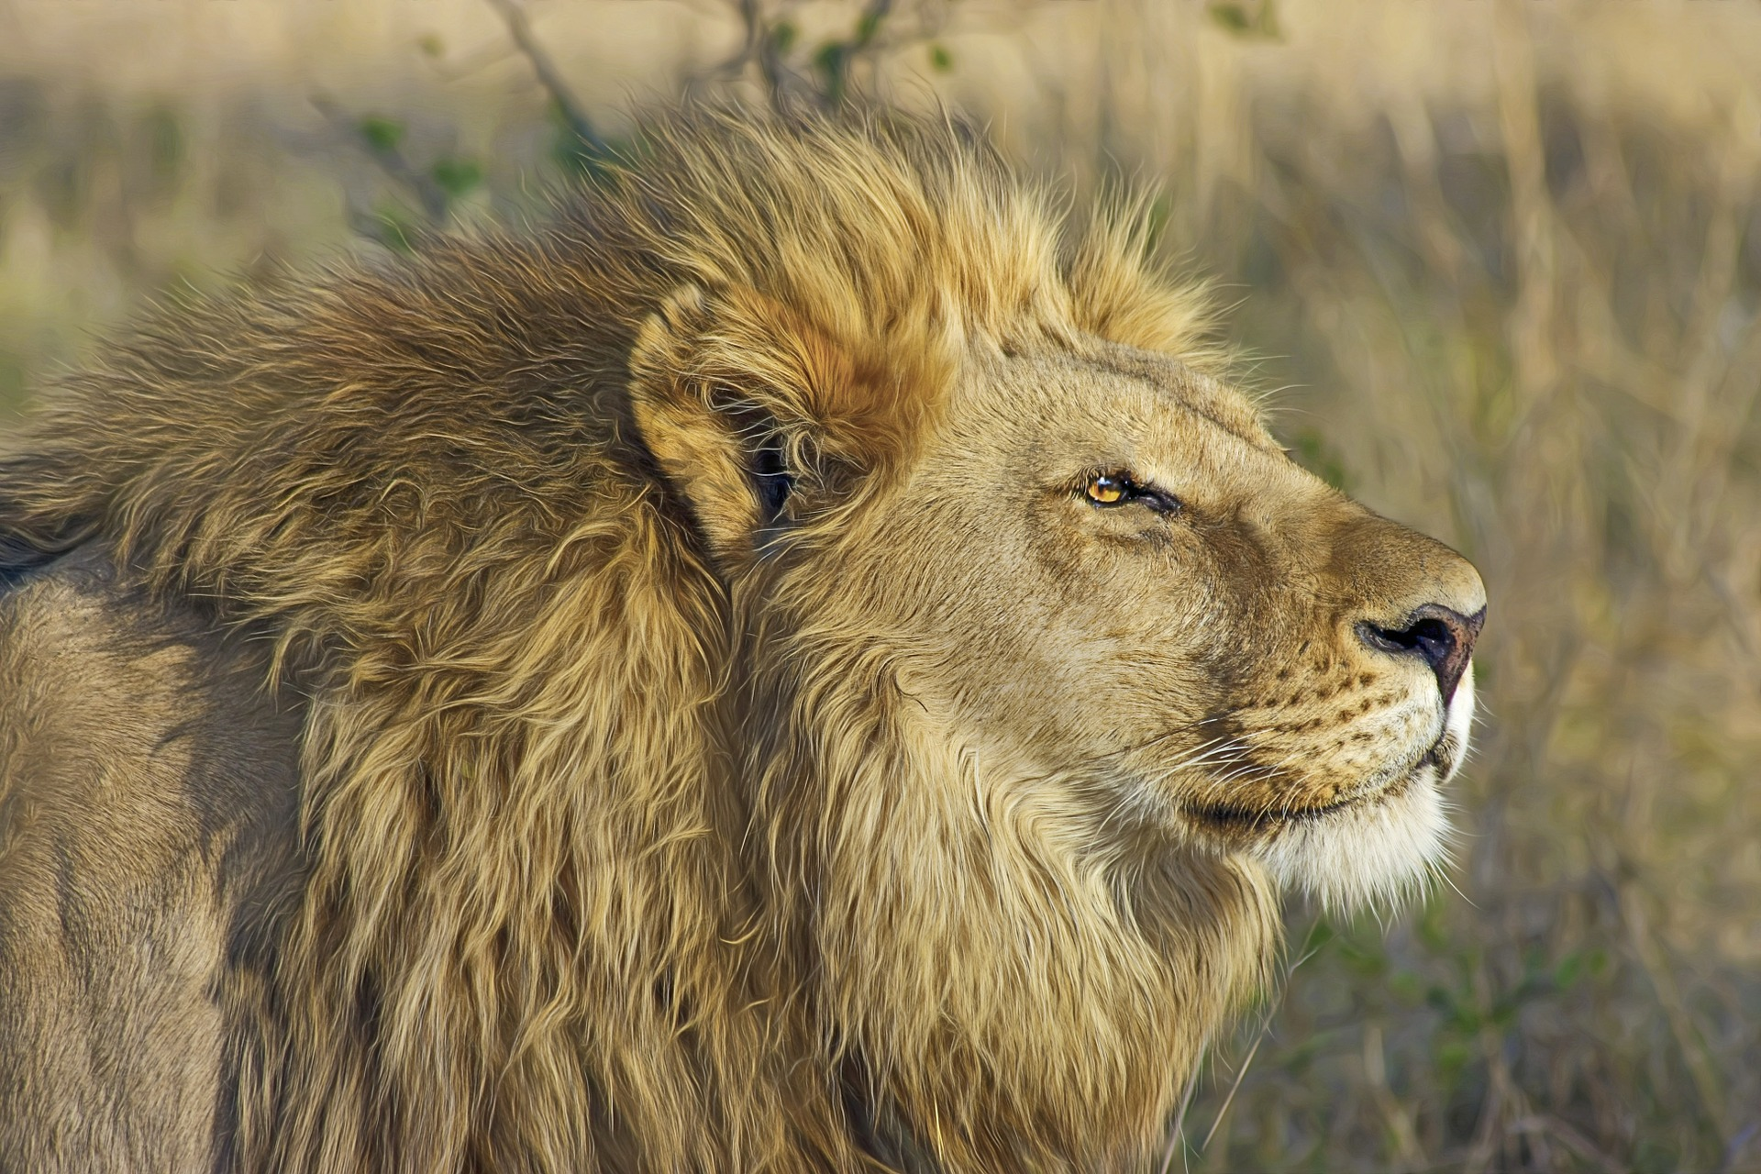
Classification
LION
WILDLIFE
MAMMAL
Notes:
Classification is a common application of machine learning.
The system determines which class or category an example belongs to.
The output can be a label and a percentage of confidence.
For example if the classifier was trained to identify whether or not an image was of a lion it might output "Yes" or "No", however if it was more generically an animal classifier the output could be "lion" or "tiger".
Classification systems depend on a threshold set by human developers so the system can distinguish between cases that might be less clear. If you built an email spam classifier it would be necessary to fine-tune the threshold so your system didn't incorrectly label an email as spam when it was genuine.
Classification diagram source: Google
Lion image from Pixabay. Free for commercial use no attribution required.

Slide 6

Neural Networks
ACTIVATED NEURONS
INPUT LAYER
OUTPUT LAYER
Image adapted from becominghuman.ai by Venkatesh Tata
Notes:
What is a neural network?
In short it’s a mathematical function that maps a given input to a desired output.
In the Introductory module, you learned about a couple types of machine learning models such as classification, regression, etc. Simple models work fine work simple data but as soon as you want to interpret complex data like an image, audio, or even numerical data with lots of variables e.g. for housing prices = location + number of bedrooms + size + etc you need something capable of dealing with that complexity.
These simpler models are connected into layers and this is where the depth of "deep" learning comes from.
In reality a neural network is a big complex mathematical function which looks nothing like what you see here but the diagram may help you see what's going on.
Like any other machine learning system, a model is trained with data fed into the model and it attempts to make a prediction. At first the prediction will be essentially garbage but that feedback is used to improve the model.
Once the prediction quality is sufficient, the model is tested with new data and it makes a prediction based on what it learned from the training data.
What this diagram doesn't show is how each neuron is able to learn and improve based on feedback. Let's look more deeply at how a neuron is able to make a decision.
Image adapted from becominghuman.ai by Venkatesh Tata

Slide 7
Transfer Learning
Output Labels
Output Labels
Source Model
Source Model
Source Data
New Data
(different domain)
Notes:
The exciting thing about pre-trained models is we can transfer learning from one pre-trained model to another task.
Similar to a human who learned to play piano, transferring some of that knowledge and skill to guitar.
The intuition behind transfer learning is that if a model trained on a large and general enough dataset, this model will effectively serve as a generic model of the visual world. You can then take advantage of these learned feature maps without having to start from scratch training a large model on a large dataset.
In this coding activity, you will try two ways to customize a pretrained model:
Feature Extraction: Use the representations learned by a previous network to extract meaningful features from new samples. You simply add a new classifier, which will be trained from scratch, on top of the pretrained model so that you can repurpose the feature maps learned previously for our dataset.
You do not need to (re)train the entire model. The base convolutional network already contains features that are generically useful for classifying pictures. However, the final, classification part of the pretrained model is specific to original classification task, and subsequently specific to the set of classes on which the model was trained.
Fine-Tuning: Unfreezing a few of the top layers of a frozen model base and jointly training both the newly-added classifier layers and the last layers of the base model. This allows us to "fine tune" the higher-order feature representations in the base model in order to make them more relevant for the specific task.

Slide 8
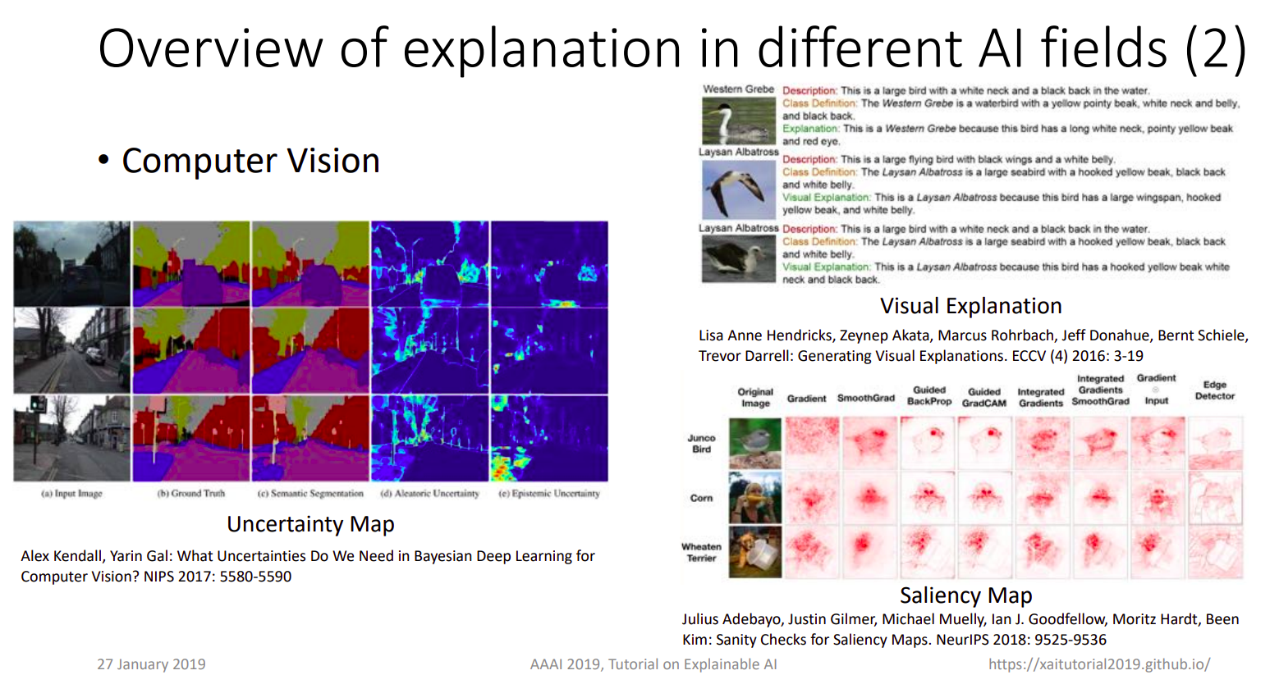

Slide 9
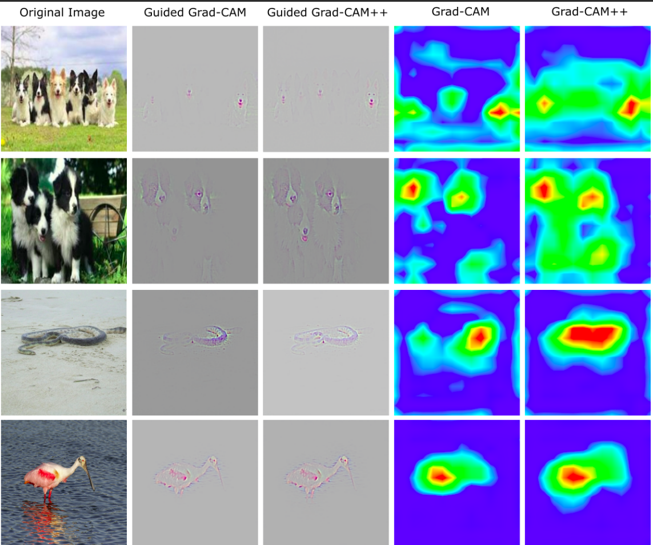

Slide 10
Categorizing the Efforts
Post-Hoc vs Ante-Hoc
Model-agnostic vs Model-Dependent
Global vs Local

Slide 11
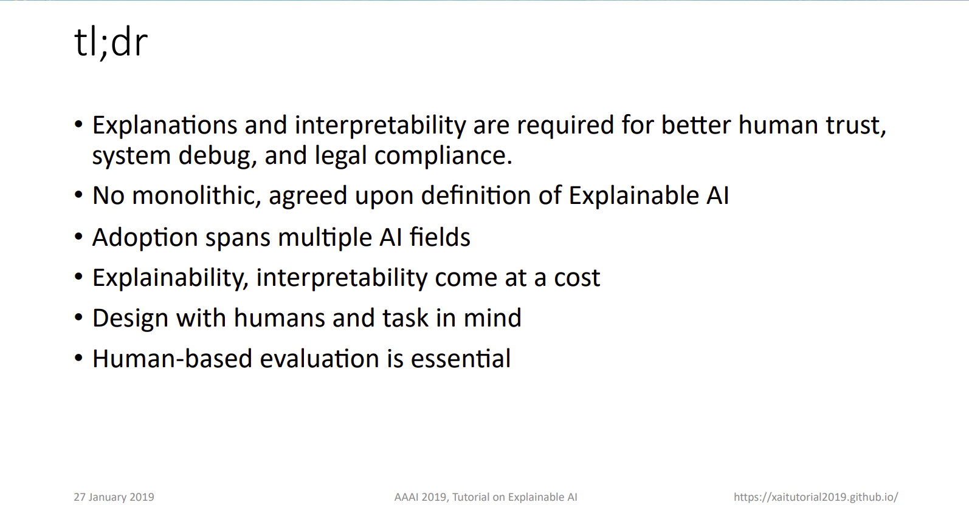

Slide 12
Live Demos:
Classification with Transfer Learning and Fine-tuning: with dogs-vs-cats dataset
Explainable CV Repo: Specifically the Layerwise Feature Activation Map

Slide 13
Resources:
Explainable AI: xaitutorial2019.github.io
adityac94/Grad_CAM_plus_plus: A generalized gradient-based CNN visualization technique
insikk/Grad-CAM-tensorflow: tensorflow implementation of Grad-CAM (CNN visualization)
Lecture Video on XAI: https://www.youtube.com/watch?v=2nUiVJiVchw

Slide 14


Slide 15
If I missed any of your questions, find me on:
LinkedIn: https://www.linkedin.com/in/phreakyphoenix/
Twitter: https://twitter.com/phreakyphoenix
Email : adityajyotipaul007@gmail.com
Github: https://github.com/phreakyphoenix
The recording for this workshop will soon be made available on YouTube. Stay Tuned!

